Slide 1
WINSLOW TOWNSHIP 2022 BUDGET PRESENTATION
PRESENTED BY JOSEPH GALLAGHER
AND
STEPHEN DRINGUS

Slide 2
Overview of 2022 General Budget
General Budget:
No reduction in the level of services.
1.49 cent increase in the municipal purpose tax rate ($26.45 per year on the average assessed value home of $176,500).
Provides continued funding of Economic Development initiatives, which have added over $70 million in new tax ratables since 2014.
Despite the Pandemic, The results of 2021 operations have allowed us to maintain our healthy balance between keeping both our fund balance and municipal purpose tax rate stable, which are both key factors that bond rating agencies look at when assigning a bond rating. Strategic planning and staggering of our bond sales has played a significant role in these results.

Slide 3
TOWNSHIP OF WINSLOW
MUNICIPAL PURPOSE TAX RATE COMPARISON - 2021 to 2022
 |  |  | 2021 |  | 2022
Amount to be Raised by Taxation -
Municipal Purposes |  |  | $ 17,125,000.00 |  | $ 17,670,000.00
Net Taxable Valuation |  |  | $ 2,675,481,007.00 |  | $ 2,697,470,168.00
Municipal Purpose Tax Rate |  |  | 0.00640072 |  | 0.00655058
Average Assessed Value |  |  | $ 176,500.00 |  | $ 176,500.00
Municipal Purpose Tax |  |  | $ 1,129.73 |  | $ 1,156.18
 |  |  | Dollar Impact | Rate Impact
2022 |  |  | $ 1,156.18 | 0.00655058
2021 |  |  | $ 1,129.73 | 0.00640072
Increase/(Decrease) Based Upon Average Assessed Value |  |  | $ 26.45 | $ 0.0001499
 |  |  |  | 1.49 Cent increase
 |  | Value | 2022 | 2021 | Variance
 |  | $ 150,000.00 | $ 982.59 | $ 960.11 | $ 22.48
(Average Assessed Value) |  | $ 176,500.00 | $ 1,156.18 | $ 1,129.73 | $ 26.45
 |  | $ 200,000.00 | $ 1,310.12 | $ 1,280.14 | $ 29.97
 |  | $ 250,000.00 | $ 1,637.65 | $ 1,600.18 | $ 37.47
 |  | $ 300,000.00 | $ 1,965.17 | $ 1,920.22 | $ 44.96

Slide 4
SUMMARY OF CHANGES IN PERSONNEL BY DEPARTMENT
DEPARTMENT | 2018 | 2019 | 2020 | 2021 | 2022
Administration | 11 FT/1PT | 11 FT/1PT | 10 FT/1PT | 10 FT/1PT | 11 FT/1PT
Assessing | 3 FT/1 PT | 3 FT/1 PT | 3 FT/1 PT | 2 FT/1 PT | 2 FT/1 PT
Clerk’s Office | 6 | 6 | 6 | 6 | 6
Court Office | 6 | 6 | 5 | 4 | 6
Construction Office | 6 FT/4 PT | 6 FT/4 PT | 6 FT/4 PT | 6 FT/4 PT | 6 FT/4 PT
Health | 1 | 1 | 2 | 2 | 2
Public Works | 33 FT/ 1 PT | 33 FT/ 1 PT | 33 FT/ 1 PT | 33 FT/ 1 PT | 36 FT/ 1 PT
Police Department* | 88* | 87* | 86* | 86* | 95*
Planning and Zoning | 2 | 2 | 2 | 2 | 2
Treasury | 3 | 3 | 3 | 3 | 3
Tax Collection | 5 | 5 | 5 | 5 | 5
Water and Sewer | 11 | 12 | 12 | 11 | 12
Totals | 169 FT/15 PT | 169 FT/15 PT | 167 FT/15 PT | 164 FT/15 PT | 178 FT/15 PT
*Police Officers | 75 &3 SP2 | 74 &3 SP2 | 74 &3 SP2 | 74 &3 SP2 | 80 & 3 SP2
*Non-police | 7 | 7 | 6 | 6 | 7
*Part time | 5 | 5 | 5 | 5 | 5

Slide 6
History of Grants
GRANTS AWARDED
 | 2017 | 2018 | 2019 | 2020 | 2021 | Total
Clean Communities | $ 84,417.20 | $ 80,823.63 | $ 88,407.41 | $ 79,729.31 | $ 84,844.02
Safe & Secure Neighborhoods | $ 60,000.00 | $ 60,000.00 | $ 60,000.00 | $ 60,000.00 | $ 32,400.00
Drunk Driving Grants | $ 7,083.59 |  |  | $ 29,644.10 | $ 9,760.75
Bulletproof Vests/Body Armor | $ 11,547.92 | $ 8,360.00 | $ 7,233.90 | $ 13,204.67
N.J. Sustainability
JAG Law Enforcement
Recycling | $ 63,422.10 |  | $ 36,697.59 | $ 36,697.59 | $ 39,943.20
Police Body Cameras |  |  |  |  | $ 199,724.00
Cross County Connection | $ 3,060.00 | $ 2,750.00 | $ 2,922.50 | $ 2,500.00 | $ 2,500.00
SJ Gas Grant |  |  |  | $ 1,000.00
Alcohol Education & Rehabilitation Grant |  | $ 3,698.24
State Community Partnership Grant |  |  | $ 5,416.66
Municipal Aid-Road Program
NJDOT Grants |  | $ 522,256.00 |  | $ 339,385.00
Camden County Open Space Grant | $ 65,360.00 |  | $ 50,000.00 |  | $ 50,000.00
or Get Pulled Over, Distracted Driver Crackdown) | $ 4,762.50
Unsafe Properties Demolition Program
Hazard Mitigation Grant-Generator Acquisition
NJ Transportation Trust Fund-Road Program |  |  | $ 316,452.00
Hepatitis Innoculation Grant
Emergency Management | $ 10,000.00 | $ 10,000.00 | $ 10,000.00 | $ 10,000.00 | $ 10,000.00
FEMA/State Storm Reimbursement
CDBG | $ 144,000.00 | $ 84,000.00 | $ 108,022.00
Municipal AllianceAgainst Drug & Alcohol Abuse:
Grant | $ 23,636.00 | $ 22,926.92 | $ 22,926.92
Municipal Match | $ 5,909.00 | $ 5,731.73 | $ 5,731.73
Recycling Bonus: Grant
Grant
Municipal Match
Total | $ 483,198.31 | $ 800,546.52 | $ 713,810.71 | $ 572,160.67 | $ 429,171.97 | $ 2,998,888.18
Total Grant Funds | $ 477,289.31 | $ 794,814.79 | $ 708,078.98 | $ 572,160.67 | $ 429,171.97 | $ 2,981,515.72 | 99.42%
Total Municipal Matches | $ 5,909.00 | $ 5,731.73 | $ 5,731.73 |  |  | $ 17,372.46 | 0.58%

Slide 9
Doing More With Less and More Efficiently
DEPARTMENT | 2008 | 2022
Administration | 4 | 11 FT/1PT
Assessing | 4 | 2 FT/1 PT
Clerk’s Office | 7 | 6
Court Office | 6 | 6
Construction Office | 13 | 6 FT/4 PT
Health | 1 | 2
Public Works | 40 | 36 FT/ 1 PT
Police Department* | 115 | 95*
Planning and Zoning | 2 | 2
Treasury | 8 | 3
Tax Collection | 6 | 5
Water and Sewer | 15 | 12
Totals | 215 FT/15 PT | 178 FT/15 PT
*Police Officers | 92 | 80 & 3 SP2
*Non-police | 17 | 7
*Part time | 6 | 5
This represents a 16.08% decrease in employees from 2008 -2021

Slide 10
2021 Progress In Services
Township Mobile app “My Winslow” is showing steady usage and growth – with expanded options to include push notifications to residents.
Mapping technology expanded to be mobile-friendly and additional maps added
Increased Social Media presence to keep residents updated during pandemic –Facebook, Twitter, Nixle & Next-door
Public meeting agendas always online and searchable for residents – enabled meetings to continue during pandemic via zoom with zero disruption
Township reviewing additional ways to increase inter-department connectivity and ease of resident access of services via web-based programs for permit process

Slide 11
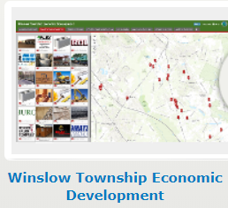
Township Mapping System During “pandemic” year – more vital to have Township services at resident’s fingertips. Available via the Township website and app – My Winslow 2021
Trash Collection
Leaf Collection
Business Listing
Polling
Places
Parks
2,015
1,101
408
516
110

Slide 12
Utilities Department 2022
The Winslow Township Utilities Water Distribution System consists of:
Approximately 150 miles of Water Main
Approximately 11,165 Water Meters and Connections
710 Fire Hydrants
2 Elevated Water Storage Tanks
3 Water Treatment Facilities
7 Water Pumping Facilities
The East Elmtowne Water Distribution System consists of:
Approximately 4.3 miles of Water Main
Approximately 211 Water Connections
2 Water Pumping Facilities
The Winslow Township Utilities Sewer Collection System consists of:
Approximately 102.4 miles of Sewer Main
Approximately 9,562 Sewer Connections
1,800 Sewer Manholes
18 Sewer Pumping Stations

Slide 13
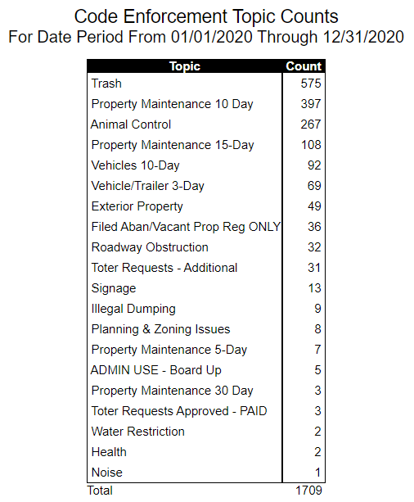
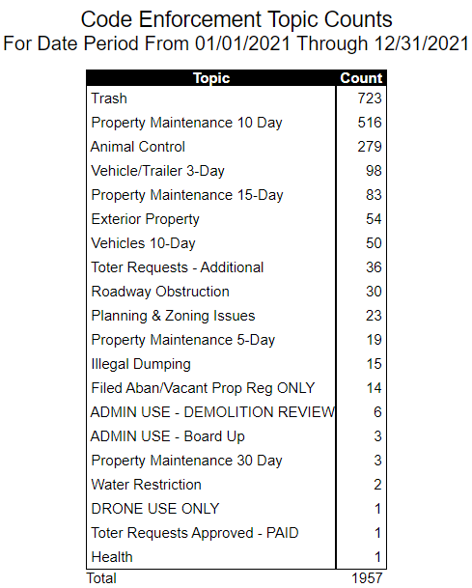
Code Enforcement/Animal Control Cases
2020 vs. 2021 – up Aprox. 13% in Cases
(Increase mostly seen in trash and property maintenance cases)
13

Slide 14
Public Works Cases 2020 vs. 2021
Public Works | # Cases 2020
Additional Toter Approved | 0
City Trees | 125
DPW-Miscellaneous | 164
Litter | 28
Potholes | 80
Snow Removal | 0
Storm Drains | 35
Street Signage | 70
Street Sweeping | 18
Toter Repair | 41
Trash-One Time Bulk Pick-Up | 182
Trash/Recycling Missed | 842
White Goods Pick-Up | 1285
TOTAL | 2870
Public Works | # Cases 2021
Additional Toter Approved | 1
City Trees | 77
DPW-Miscellaneous | 203
Litter | 28
Potholes | 115
Other | 10
Storm Drains | 24
Street Signage | 85
Street Sweeping | 42
Toter Repair | 68
Trash-One Time Bulk Pick-Up | 191
Trash/Recycling Missed | 807
White Goods Pick-Up | 1096
TOTAL | 2747

Slide 15
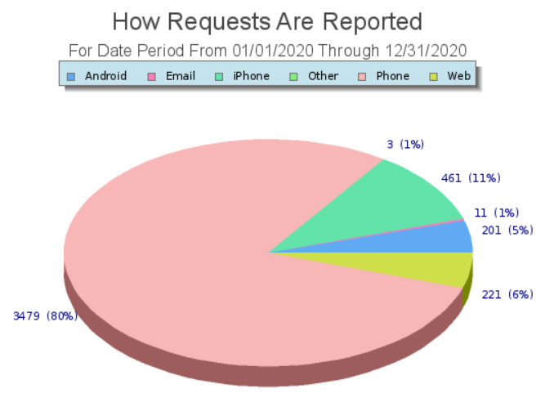
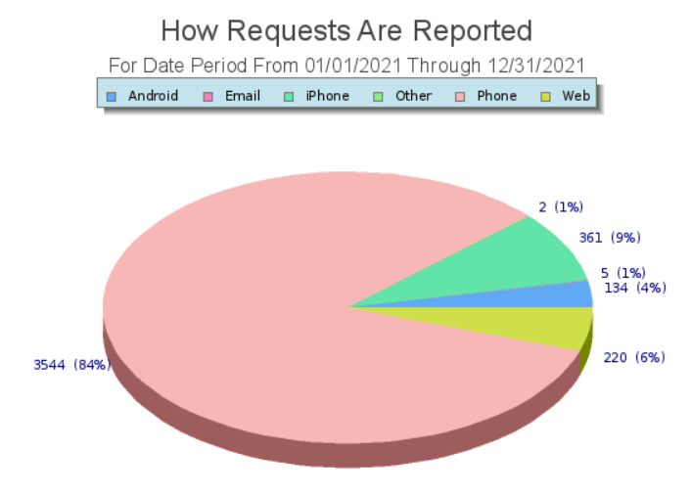
How service requests are received from residents remained steady throughout the years – but during the pandemic slightly more residents utilized the My Winslow app to make reports.
2020 Total Requests
4,376
2021 Total Requests
4,266

Slide 16
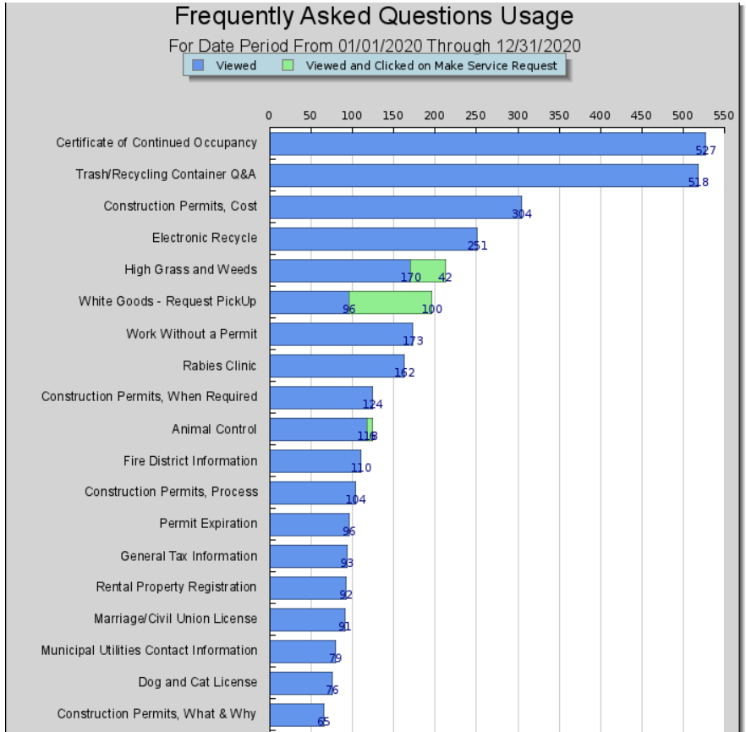
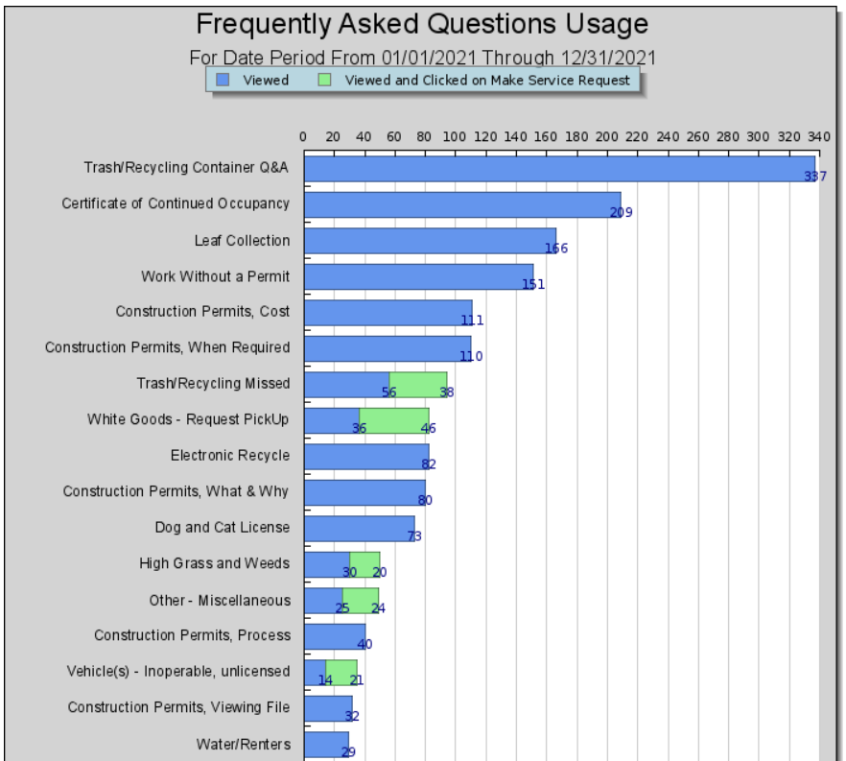
Township Mobile App and Website FAQ Portal
Frequently Asked Questions Available 24/7
2020
2021
Most items decreased by almost half. Which shows information is getting to residents and less “questions” are being received related to services!

Slide 17
Major Appropriation Line Item Changes
 | Increase/(Decrease)
Solid Waste Collection/Landfill Disposal Costs (Contractual/Recycling) | $115,100.00
Employers Pension Contribution (Statutory) | $138,311.00
Police (Contractual) | $228,000.00
Interest on Bonds | ($58,856.00)
Reserve for Uncollected Taxes | ($485,203.00)
Utility and Bulk Purchases (Gasoline/Fuel Oil) | $130,500.00

Slide 18
Solid Waste/Recycling Disposal Costs

Slide 19
Estimated

Slide 20
FUTURE 2022 AND BEYOND…
Continue to explore shared services options with Camden County and other Municipal Governments
Continuous Evaluation of how services are provided in an effort to reduce spending.
Continue Winslow’s efforts to “Market” the Township, and develop strategic Economic Development Plans.
Continue our “Green Efforts” by reducing energy costs through our :
Continuing our efforts in exploring solar opportunities
Building or EV Fleet and Infrastructure
Energy Consortium (bids out our energy costs)

